Slide 1

ECON 128 FINAL
Michael Evans

Slide 2
Outline
Q1 | Q2 | Q3 | Q4
Data Cleaning | Model Training | Predictions | Evaluation
- Unavailable Data | - Subset Selection/PCA | - Data Organization | - Final Results
- Inconsistent Data | - Lasso/Ridge Models | - Predicting w/Lasso + Ridge | - Comments

Slide 3
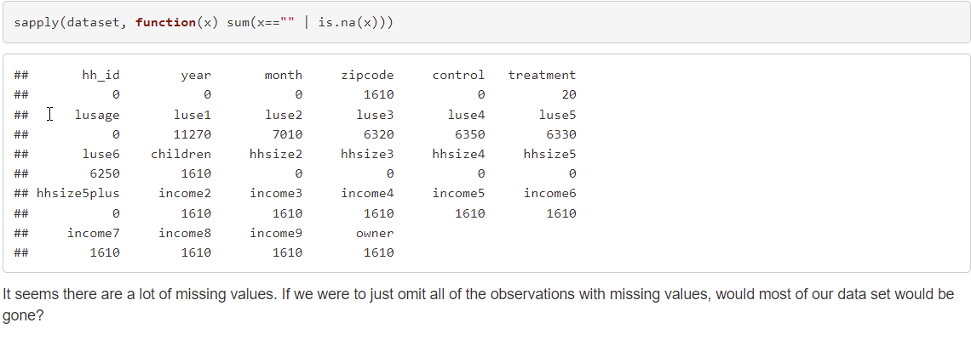
Data Cleaning – Unavailable Data

Slide 4
Data Cleaning – Unavailable Data
I omitted all NA/blank parts of the data.
Beyond missing values, there were several instances of data that was mislabeled.

Slide 5
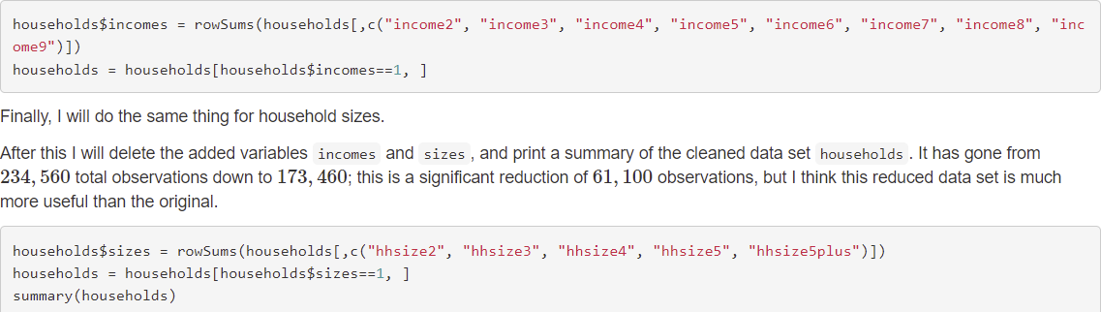
Data Cleaning – Inconsistent Data

Slide 6
Data Cleaning – Inconsistent Data
I checked for mislabeled data and decided to remove:
- Observations not made in 2010 or 2011
- Observations not made in April to August
- Labeled as both “Control” AND “Treatment” (or neither)
- Labeled as more than 1 income category (or no income category recorded)
- Labeled as more than 1 household size (or no household size recorded)
Totaling 61,000 observations removed, leaving 173,460 for modelling.

Slide 7
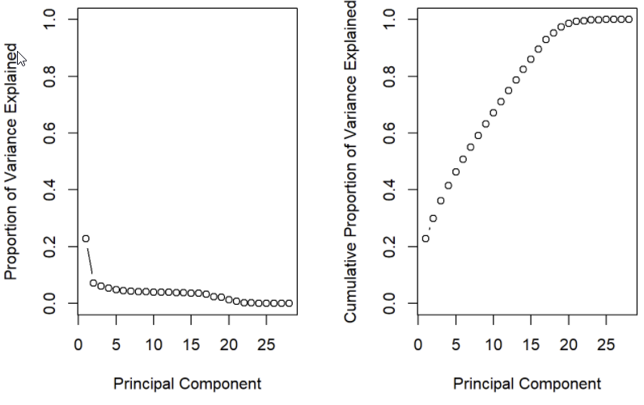
Model Training – PCA
The first principal component has a much greater effect on the PVE.
Everything else is way less impactful.

Slide 8
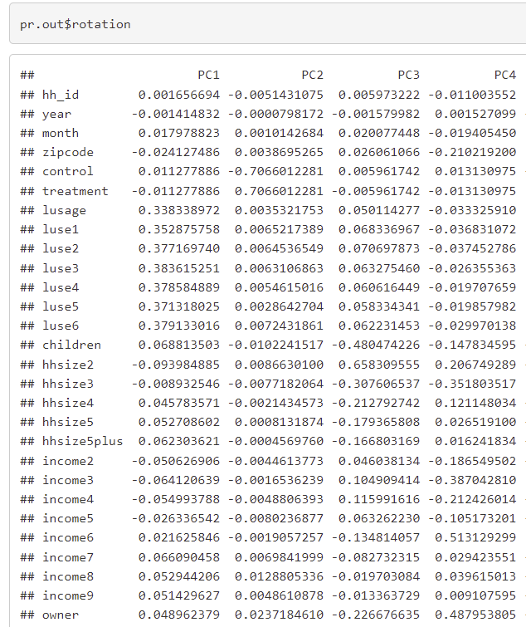
Model Training – PCA
Taking a look at the principal components, principal component 1 (which explains much more variance than any other principal component) focuses primarily on the previous power usage.
I know it’s hard to see from this screenshot. If you would like to see more, please see the attached HTML or .Rmd files.
This emphasis on previous energy consumption can be a clue for modeling later.

Slide 9
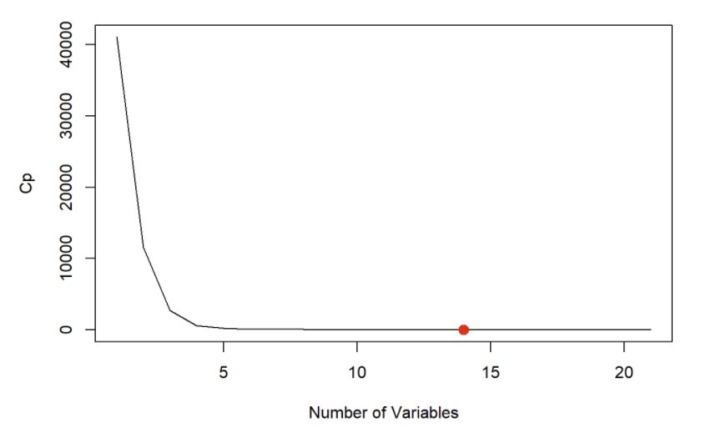
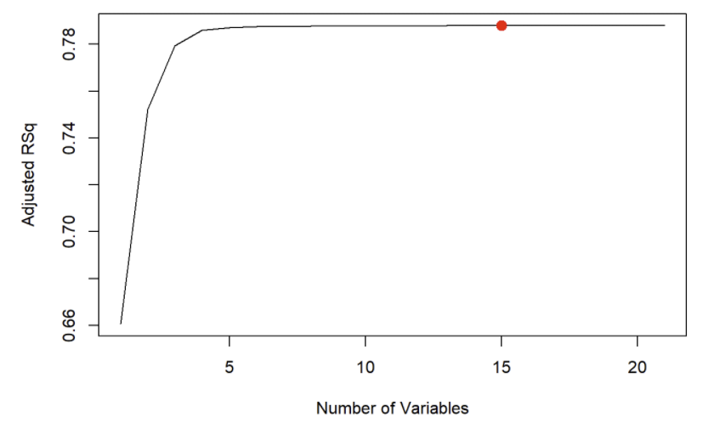
Model Training – Subset Selection

Slide 10
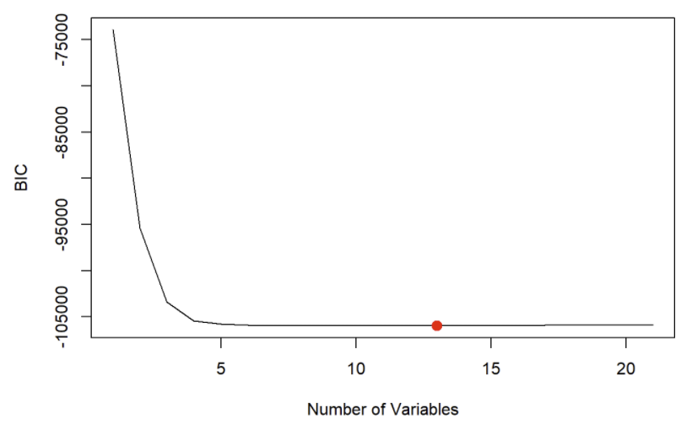
Model Training – Subset Selection
All of the performance metrics indicate the optimal number (minimum or maximum of the metric) of variables is around 13-15.
However, there is not that big of a difference between, say, 15 variables and something as low as 4 or 5 variables.

Slide 11
Model Training – Data
I ended up excluding some variables due to linear dependencies and/or irrelevance to the response:
- Control (0/1)
- Treatment (0/1)
- Year
- ID #

Slide 12
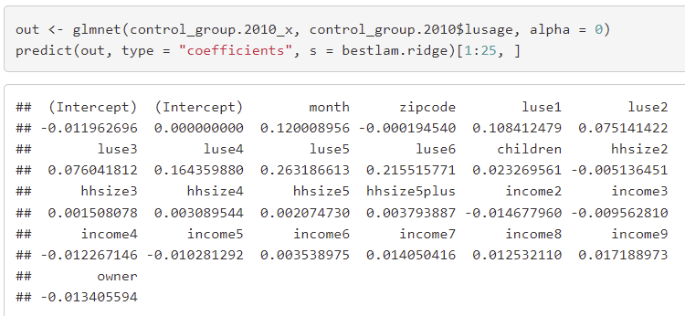
Model Training – Ridge Regression
I fit a ridge regression and optimized lambda using cross-validation.
Here are the coefficients from the model:

Slide 13
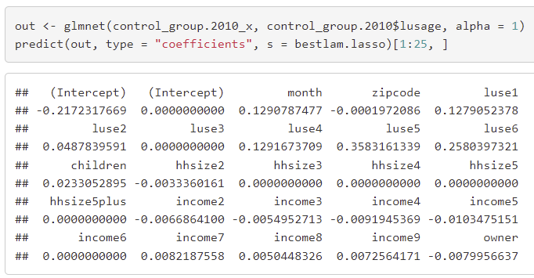
Model Training – Lasso Regression
I also fit a lasso regression and optimized lambda using cross-validation.
Here are the coefficients from the model:

Slide 14
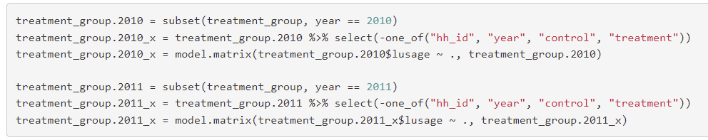
Predictions – Data Organization
Before, I was only looking at the CONTROL portion of the data. Now, I use the TREATMENT data for 2011 to make predictions for the response using the model(s) I fitted. For this section, I started by organizing the data:

Slide 15

Predictions – Ridge Model
ridge.pred_treatment stores the predicted values for the electricity
consumption of the TREATMENT group in 2011 using the ridge model

Slide 16

Predictions – Lasso Model
lasso.pred_treatment stores the predicted values for the electricity
consumption of the TREATMENT group in 2011 using the lasso model

Slide 17
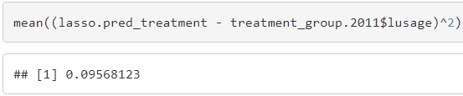
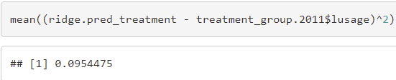
Evaluation – Final Results
Finally, I need to compare my predicted values for the 2011 TREATMENT group with the actual values for the 2011 TREATMENT group.
My lasso and ridge models actually had very similar MSE’s, with the ridge just barely improving over the lasso.

Slide 18
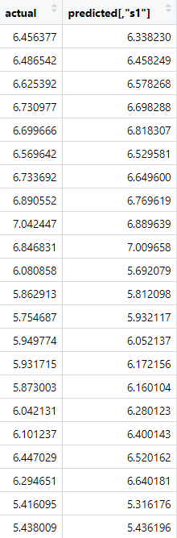
Evaluation - Comments
I appended the predicted values to the treatment data, so that it is easier to compare them.
treatment_group.2011 has two new columns: lusage copied to a new column at the end for easier comparison with the name actual, and predicted, the values estimated by the ridge regression model.

Slide 19
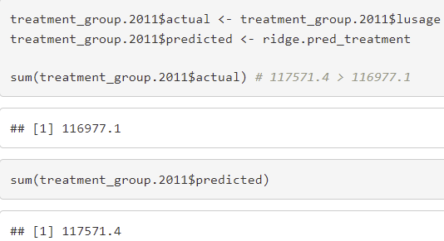
Evaluation - Comments
I haven’t perused the differences in values extensively, but it seems that my predicted values are pretty close to the actual values.
It seems that, overall, my model overestimates the amount of electricity people consume, rather than underestimates it.

Slide 20
Conclusions
Data cleaning – Primarily omissions, checked for inconsistencies in data
Model training – Omitted linearly dependent variables, used ridge and lasso
Predictions – Stored predictions in two separate variables for evaluation
Evaluation – Used ridge model: it slightly overestimates the actual values
Finally: If you would like to see more detail, please see the .Rmd or HTML file

